Slide 1

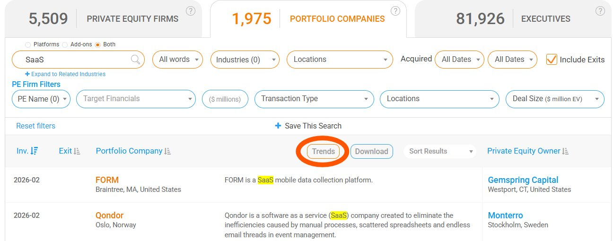
PEI Trends Dashboard
Instant Market Insights, Now Just One Click Away
4
Key Market Lenses
Acquisition Volume · Holding Period Stats · Deal Geography · Platform vs. Add-ons
We're excited to launch Trends — a new PEI dashboard that transforms raw search data into instant insights. You might have granular results, but lack the bigger picture: Is the SaaS sector heating up? Which regions are driving deal activity? With Trends, that insight is now just one click away.
Trends Dashboard from Private Equity Info | SaaS search example: 5,509 PE Firms · 1,975 Portfolio Companies · 81,926 Executives
Source: Private Equity Info Database | privateequityinfo.com | April 2026

Slide 2
Analysis & Implications
From Search to Insights
What Trends Shows You
Searching portfolio companies on PEI delivers a strong dataset, but understanding how that market evolves has traditionally required additional effort. You might have granular search results but lack the bigger picture — with Trends, that insight is now just one click away.
The Trends dashboard gives a comprehensive view of market activity through four key lenses: Acquisition Volume (identify investment cycles), Holding Period Stats (gauge exit timing and fund strategy), Deal Geography (uncover regional trends), and Platform vs. Add-ons (how firms build value).
Also Available at the Firm Level
Why This Matters
Trends is not limited to industry searches. Users can access the same insights when viewing specific Private Equity firms, allowing evaluation of firm-level strategies and activity patterns with ease — giving dealmakers a granular view of sponsor behavior unavailable through traditional research.
With Trends on PEI, professionals can spot market momentum and shifts in deal activity, compare strategies across industries and firms, support insights with clear visual data, and reduce time spent on manual analysis — directly accelerating deal sourcing and investment decision-making.
Dashboard Context: The Trends dashboard transforms PEI search results into instant market intelligence. A SaaS search surfaces 5,509 PE firms, 1,975 portfolio companies, and 81,926 executives. With a median exit holding period of 4.5 years and 57.3% add-on deal activity, Trends gives sponsors the real-time visibility to identify investment cycles, benchmark strategies, and act at the right moment.
Source: Private Equity Info Database | privateequityinfo.com | April 2026

Slide 3
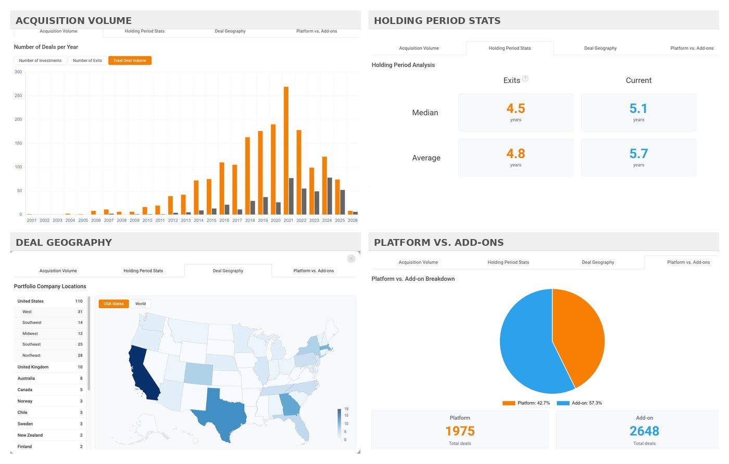
Trends Dashboard — Four Key Market Lenses
Acquisition Volume
Holding Period Stats
Deal Geography
Platform vs. Add-ons
Identify deal cycles over time
Gauge exit timing and fund strategy
Uncover regional investment trends
Understand how firms build portfolio value
Trends is also available at the individual firm level — view firm-specific activity patterns with a single click on any PE firm page
Source: Private Equity Info Database | privateequityinfo.com | April 2026

Slide 4


About Us
Private Equity Info
TruSight, LLC
M&A Research Database
Deal Sourcing & Origination
Private Equity Info is a cutting-edge M&A research platform that lets dealmakers search, identify, and connect with key executives across the entire M&A landscape. Since 2005, our focus on data accuracy, ease-of-use, and personalized customer service has made us an invaluable partner to investment bankers, private equity firms, and other M&A professionals.
TruSight provides subscription-based deal origination, retained buy-side acquisition search, and deal sourcing services for professional investors, private equity funds, family offices, and business intermediaries. Our reputation for broadening and accelerating deal flow has been built through industry expertise, professionalism, and a partnership philosophy.
130,000 key executives across 30,900 firms
1.1 million private and public companies
AI-powered natural language search
Real-time alerts and deal tracking
Retained buy-side acquisition search
Intermediary coverage from 13,000+ contacts
Off-market proprietary deal flow
Sell-side marketing and distribution
Andy Jones
Dan Mahoney
Founder & Managing Director, Private Equity Info
Co-Founder & CEO, TruSight, LLC
Leads PEI corporate strategy, product development and growth; background in investment banking and acoustical engineering.
Leads outsourced business development and deal origination; background in financial consulting and business strategy.
Private Equity Info was acquired by TruSight, LLC in late 2021, combining cutting-edge M&A data with hands-on deal origination to create an integrated platform for the lower middle market.
Request a free trial → privateequityinfo.com
Learn more → trusightllc.com
Source: Private Equity Info Database | privateequityinfo.com | April 2026

