Slide 1

AI INVESTING
AI Investing Comes of Age
Private equity shifts from platform creation to platform expansion
M&A trends in AI platform and add-on investing | 2015 – 2026 YTD
Prepared from Private Equity Info research

Slide 2

A Maturing Market
PE-backed AI M&A activity since 2015
1,200+
AI-focused deals tracked since 2015
Source: Private Equity Info M&A Research Database
2

Slide 3
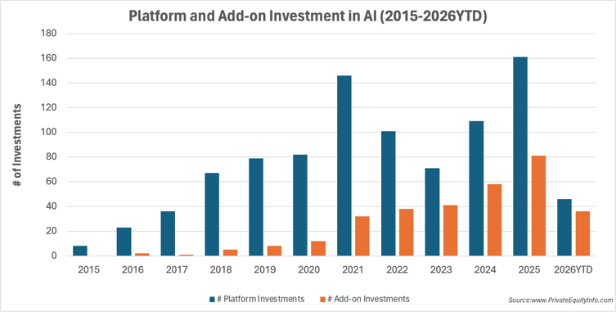
Following the Technology
Each phase of AI development has brought a distinct shift in investment activity
Platform investment continues to climb, but the sharper rise in add-ons signals a shift toward strengthening existing platforms rather than only acquiring new ones.
Platform investments in AI reached record levels in 2025 — continued investor confidence in real value, real cash flow, and exceptional growth.
Source: Private Equity Info M&A Research Database
3

Slide 4
Following the Technology
Each phase of AI development has brought a distinct shift in investment activity
1
2
3
2015 – 2020
2021 – 2023
2024 – 2026
Early Experimentation
Platform Building
Platform Expansion
AI investing looks like venture territory: frontier technology, evolving business models, and valuations built on faith.
PE capital moves in to establish foundational AI platforms across key sectors.
Add-on M&A accelerates as firms use acquisitions to strengthen and scale existing platforms.
Platform investments in AI reached record levels in 2025 — continued investor confidence in real value, real cash flow, and exceptional growth.
Source: Private Equity Info M&A Research Database
4

Slide 5
Where the Capital Is Going
Top sectors for PE-backed AI investment, ranked by activity
1
Healthcare
6
Cybersecurity
2
Core AI Platforms
7
Workforce
3
Software
8
Customer Service
4
Finance
9
Retail
5
Marketing
10
Government
Source: Private Equity Info M&A Research Database
5

Slide 6
Three Sectors to Watch
Where new platforms and add-ons are concentrating
1
2
3
Healthcare
Core AI Platforms
Software
Leading destination for new platforms
The horizontal layer across every sector
The engine of add-on activity
Regulatory clarity, large volumes of proprietary data, and durable demand make it a natural home for foundational businesses that scale within compliant environments.
The foundational infrastructure layer for AI. It ranks near the top of both platform and add-on lists because its capabilities feed every other market sector.
AI's earliest, most obvious enterprise application. Paired with recurring software revenue, it's quickly accretive — exactly what a buy-and-build thesis needs.
Source: Private Equity Info M&A Research Database
6

Slide 7
See the data behind the trends.
Explore Private Equity Info’s database and Signals in a personalized demo.
Schedule your demo
AI Investing Comes of Age: Private Equity Shifts from Platform Creation to Platform Expansion| Read the full study
Prepared from Private Equity Info research
7

